Slide 1
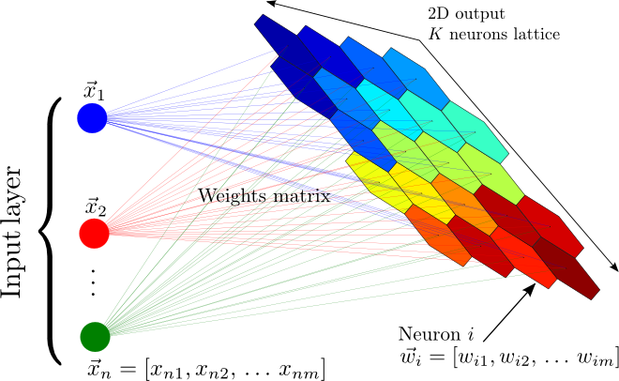
Tutorial 10
﻿CS5486 Intelligent Systems:
Self-Organizing Map and Gaussian Mixture Model
Hongzong Li
Department of Computer Science City University of Hong Kong

Slide 2
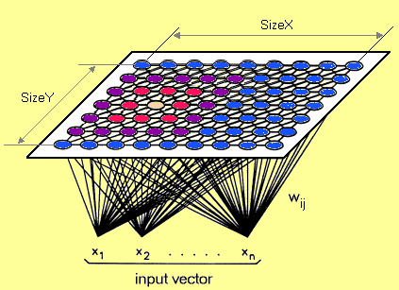
Self-Organizing Map
A Self-Organizing Map (SOM) is a type of artificial neural network used for unsupervised learning and data visualization.
It reduces high-dimensional data into a lower-dimensional (typically 2D) representation while preserving the topological relationships of the input data.
Clustering
Feature Extraction
Dimensionality Reduction

Slide 3
Self-Organizing Map
Output Layer
Output Layer (Map): A 2D grid of neurons, each associated with a weight vector of the same dimensionality as the input data.
Input Layer: Represents the feature vectors of the dataset.
Input Layer
The network organizes itself through a competitive learning process, where similar inputs map to nearby neurons.

Slide 4
Self-Organizing Map
Training:
Step 1: Initialize the weights w_{ij} random value may be assumed. Initialize the learning rate α.
Step 2: Calculate squared Euclidean distance.
D(j) = Σ (wij – xi)^2 where i=1 to n and j=1 to m
Step 3: Find index J, when D(j) is minimum that will be considered as winning index.
Step 4: Update BMU and its neighbors:
Step 5: Update the learning rule by using :
α(t+1) = 0.5 * t
Step 6: Test the Stopping Condition.

Slide 5
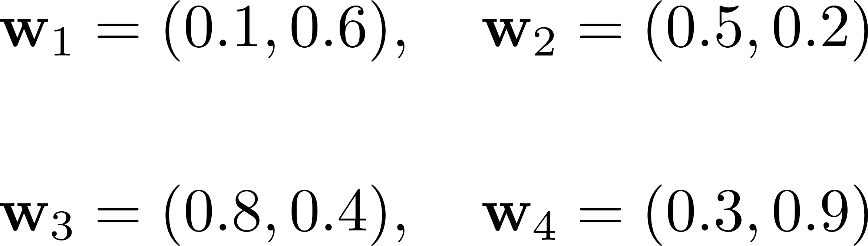
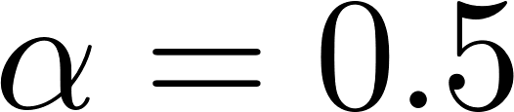
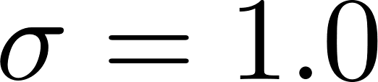
Self-Organizing Map
We have three input vectors:
The SOM grid is 2×2, meaning there are four neurons, each with a randomly initialized weight vector:

Slide 6
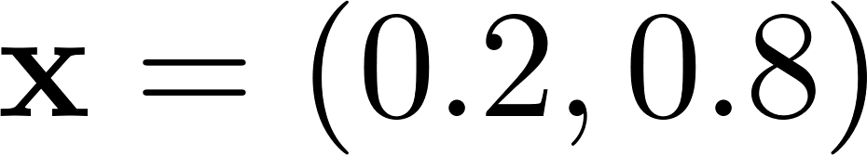
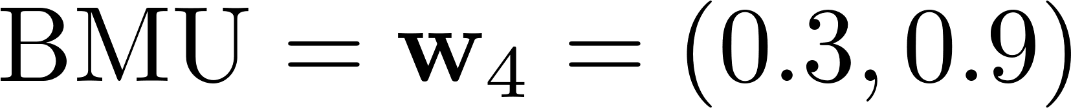
Self-Organizing Map
Step 1: We randomly select an input sample:
Step 2: We calculate the Euclidean distance between the input vector and all neurons' weight vectors:
The neuron with the smallest distance is selected as the BMU:

Slide 7
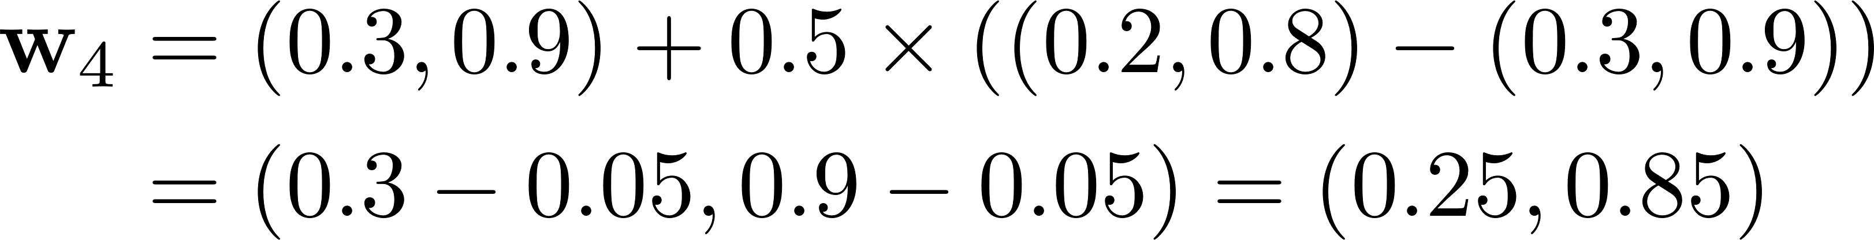
Self-Organizing Map
The neuron with the smallest distance is selected as the BMU:
Step 4: The BMU’s weight vector is updated using the following rule:
Substituting values:
Step 5: Repeat for Other Input Vectors

Slide 8
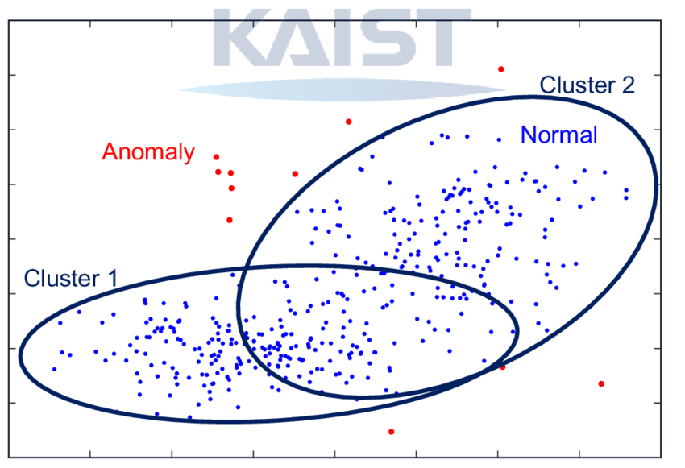
Gaussian Mixture Model
A Gaussian Mixture Model (GMM) is a probabilistic clustering algorithm that models data as a mixture of multiple Gaussian distributions. Unlike K-Means, which assigns points to the nearest cluster centroid, GMM assigns probabilities to each data point for belonging to multiple clusters.

Slide 9
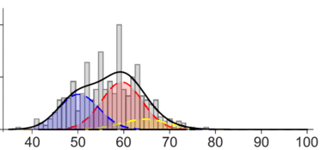
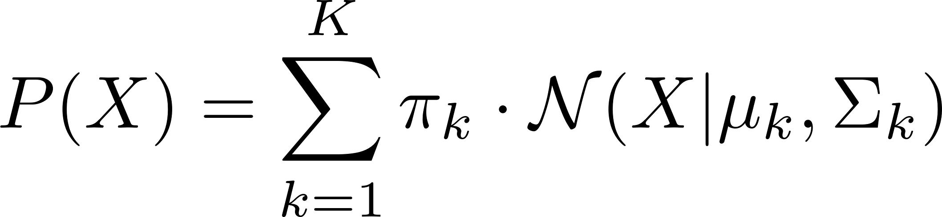
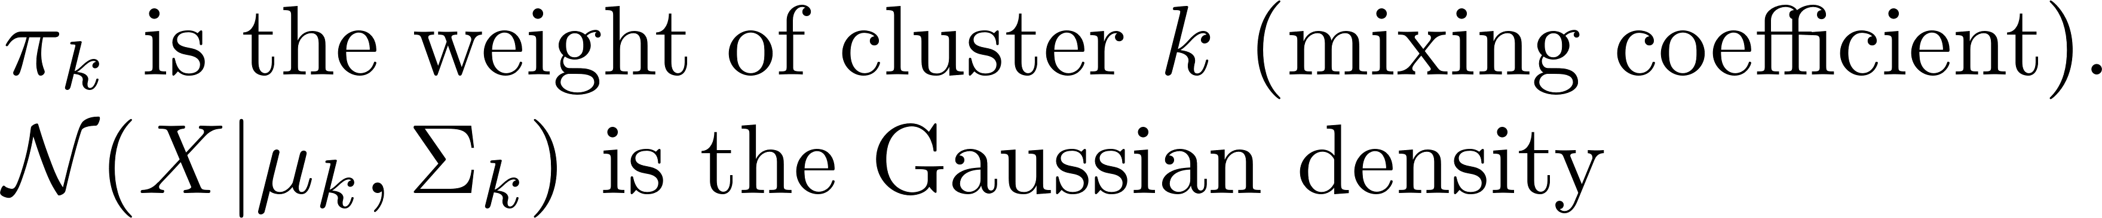
Gaussian Mixture Model
GMM assumes that the data is generated from a mixture of K Gaussian distributions, each defined by:
Mean (μ): Center of the Gaussian.
Covariance (Σ): Shape and spread of the Gaussian.
Mixing coefficient (π): Probability of selecting each Gaussian.
A GMM is formulated as:

Slide 10
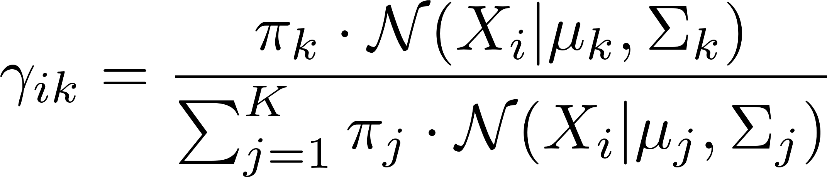
Gaussian Mixture Model
Step 1: Initialize Parameters
Randomly initialize KK Gaussian distributions with:
Initial means μk​.
Initial covariances Σk​.
Initial mixing coefficients πk​.
Step 2: Expectation (E-Step)
Compute the probability that each data point belongs to each Gaussian:

Slide 11
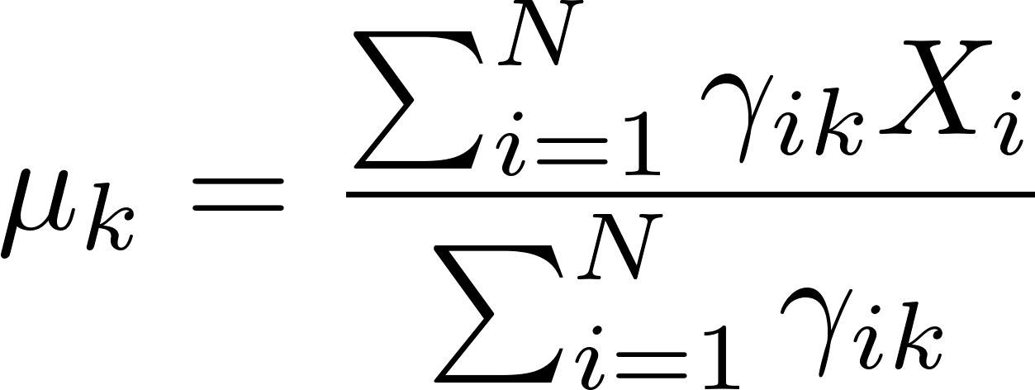
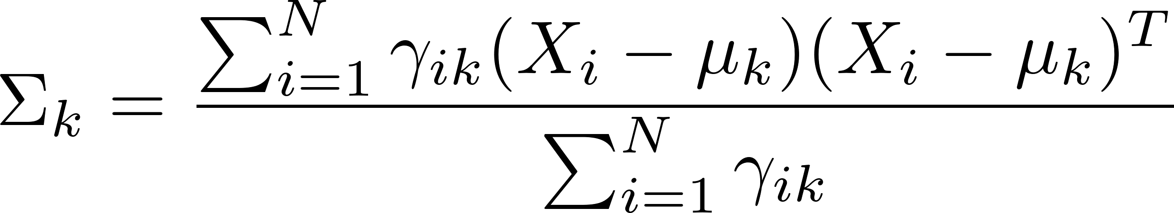
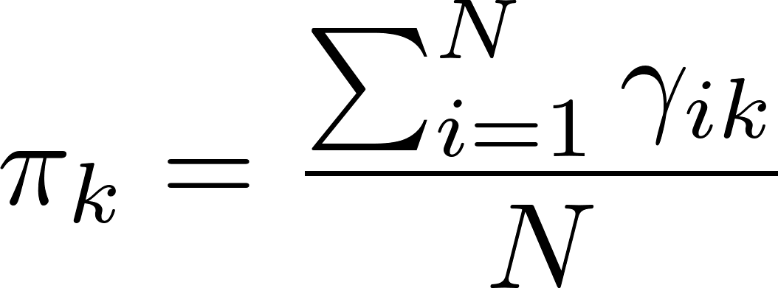
Gaussian Mixture Model
Step 2: Expectation (E-Step)
Compute the probability that each data point belongs to each Gaussian:
Step 3: Maximization (M-Step)
Update the parameters:
Step 4: Repeat Until Convergence

Slide 12
What type of learning is used in Self-Organizing Maps? A. Supervised Learning B. Reinforcement Learning C. Unsupervised Learning D. Semi-supervised Learning

Slide 13
Explain how the Best Matching Unit (BMU) is determined in a Self-Organizing Map.

Slide 14
A Gaussian Mixture Model is composed of: A. A single Gaussian distribution B. Multiple independent variables C. A weighted sum of Gaussian components D. A combination of linear regressors

Slide 15
Thanks

